Slide 1
Ixia Automation
Leadertech, Teddy Liu
August 2020

Slide 2
Ixia automation
Summary
Automation Introduction
IxExplorer Automation
IxNetwork Automation

Slide 3



















MARKET TRENDS
Driving towards automation
Existing Conditions
Trends
Ideal Conditions
Waterfall Product & Service
Development
DevOps CI, CT, CD
Continuous Delivery of Product & Service DevOps & AGILE
Manual Configuration over
Human-centric Interfaces
Zero-touch
Automation
Programmatic Configuration API Interfaces
Static Networks using
Appliance Devices
Dynamic Networks SDN VNF & PNF
AI, ML

Slide 4
Ixexplorer automation

Slide 5
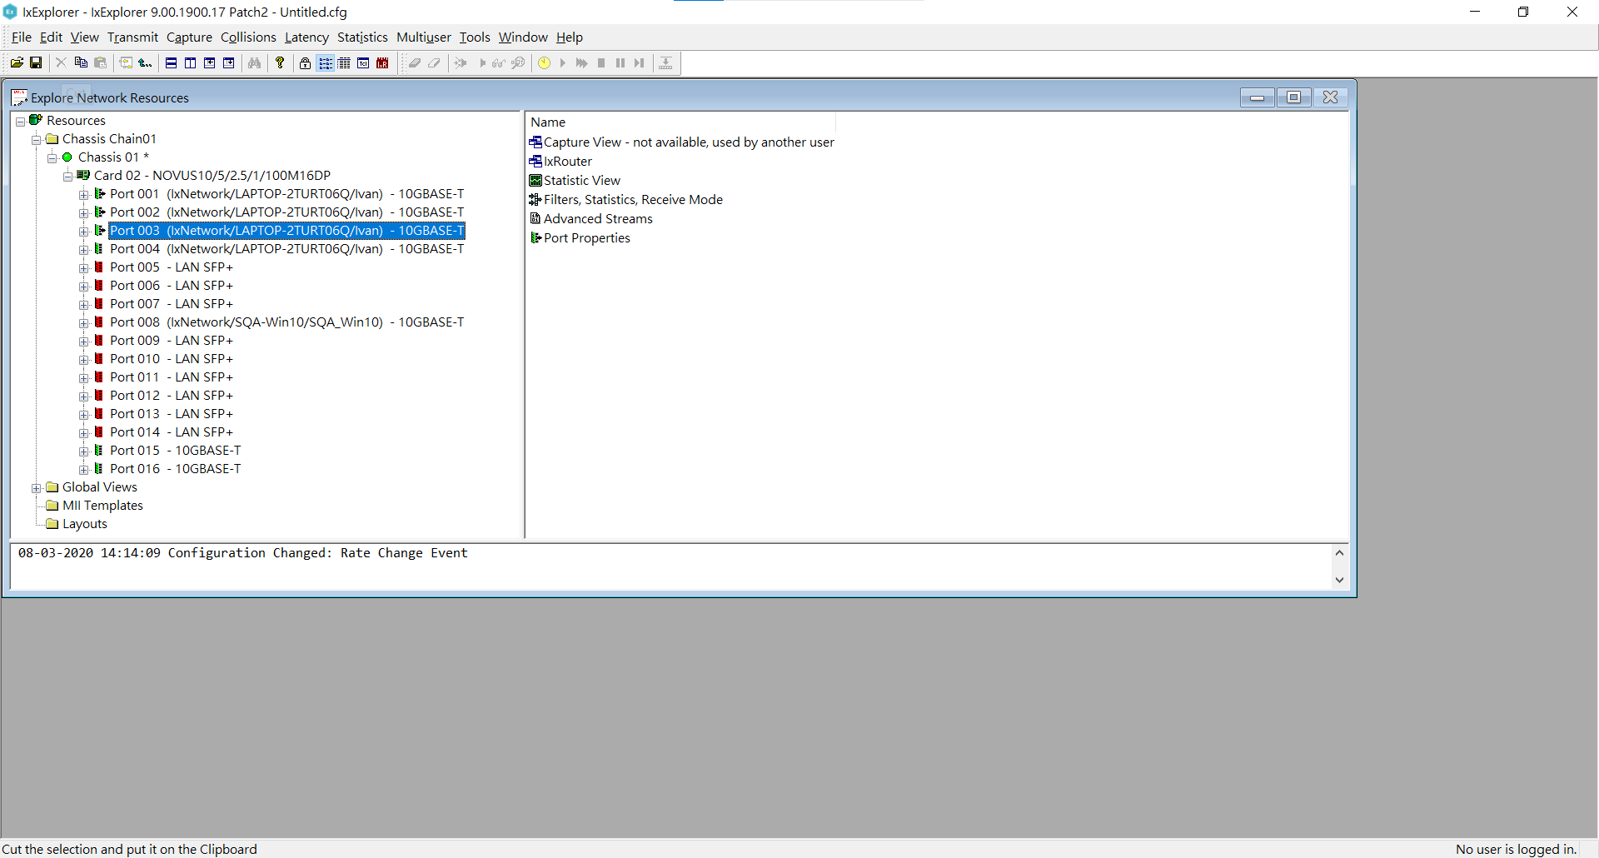
IxExplorer GUI
-Check Everything on Chassis

Slide 6

IxExplorer API
API Type
-Tcl Only
How to use
-ScriptGen
-Tcl Console
-Manual Scripting
Reference
-Tcl Development Guide

Slide 7
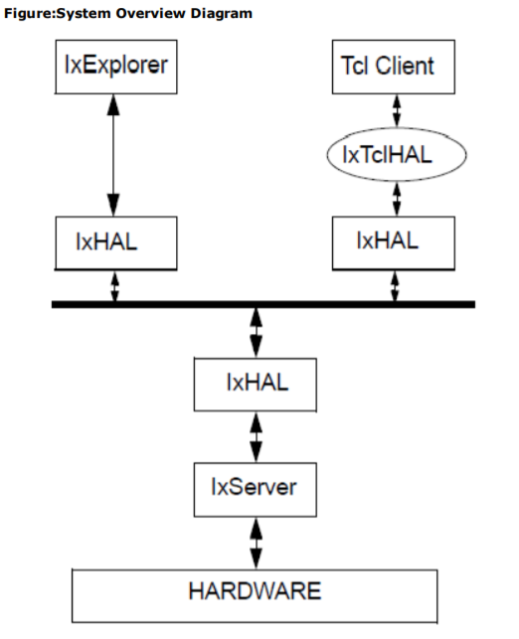
IxExplorer API
-Structure
Notes:
In the case of Tcl applications, the Tcl Command Library is a set of Tcl commands that are used to configure the traffic generation, capture and statistics parameters on the Ixia hardware platform. Tcl applications use these commands to configure test parameters and then use a ‘set’ option to transfer the information into IxHAL. A ‘write’ option causes IxHAL to send the information to the hardware. To retrieve status, captured data and statistics the application uses a ‘get’ option which retrieves the information from IxHAL into IxTclHAL. A ‘cget’ option retrieves these values for use in Tcl applications.
This chapter discusses general structure of the Ixia Tcl commands and suggested programming sequence. Most of the Tcl commands have the following same basic structure: l A number of configuration options that are used to set test and other parameters. l A standard set of options that push the data options toward the hardware and read information back from the hardware. l Additional command specific options used to perform special settings or operations.
config : Sets a specified value to a specific option, which is most often a desired hardware setting. The value is stored in an object in IxTclHAL temporarily.
cget : Gets a specified option's value, which was stored in the IxTclHAL object.
set : Information is transferred from the IxTclHAL object to the IxHal software layer, but not sent to the hardware. The set method takes as arguments the chassis ID, card number and port number being addressed.
write : Information previously transferred to the IxHal software layer is sent to the hardware. The write method takes as arguments the chassis ID, card number and port number being addressed. Although each class provides its own write method, it is usually more convenient to call ixWriteConfigToHardware, which sends all outstanding set's to the hardware at the same time.
get : Information from the hardware is read out to the IxHal layer and into the member variables. In many cases, the IxHal layer holds more information than is represented in a single set of member variables and additional methods are needed to obtain more data. The get method takes as arguments the chassis ID, card number and port number being addressed.
setDefault : Default values for the members are set.
decode : A captured frame is analyzed and appropriate member variables are set to reflect the contents of the frame.

Slide 8
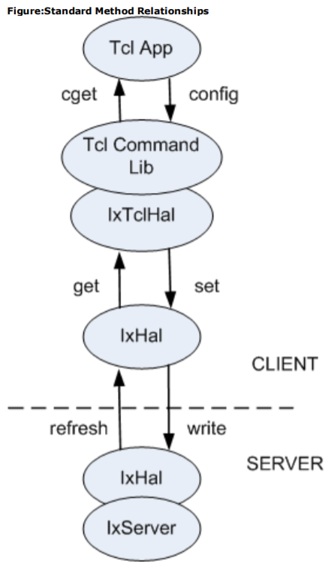
IxExplorer API
-Structure
Script
Tcl Object
Buffer
Server
Notes:
This chapter discusses general structure of the Ixia Tcl commands and suggested programming sequence. Most of the Tcl commands have the following same basic structure: l A number of configuration options that are used to set test and other parameters. l A standard set of options that push the data options toward the hardware and read information back from the hardware. l Additional command specific options used to perform special settings or operations.
config : Sets a specified value to a specific option, which is most often a desired hardware setting. The value is stored in an object in IxTclHAL temporarily.
cget : Gets a specified option's value, which was stored in the IxTclHAL object.
set : Information is transferred from the IxTclHAL object to the IxHal software layer, but not sent to the hardware. The set method takes as arguments the chassis ID, card number and port number being addressed.
write : Information previously transferred to the IxHal software layer is sent to the hardware. The write method takes as arguments the chassis ID, card number and port number being addressed. Although each class provides its own write method, it is usually more convenient to call ixWriteConfigToHardware, which sends all outstanding set's to the hardware at the same time.
get : Information from the hardware is read out to the IxHal layer and into the member variables. In many cases, the IxHal layer holds more information than is represented in a single set of member variables and additional methods are needed to obtain more data. The get method takes as arguments the chassis ID, card number and port number being addressed.
setDefault : Default values for the members are set.
decode : A captured frame is analyzed and appropriate member variables are set to reflect the contents of the frame.

Slide 9
Ixexplorer api
-Return Code
Code | Value | Usage
ixTcl_ok/TCL_OK | 0 | No error, successful return.
ixTcl_generalError/TCL_ERROR | 1 | An error has occurred.
ixTCL_versionMismatch | 2 | The software version for the TCL API does not match that used on a connected chassis.
ixTcl_ chassisTimeout | 3 | A timeout occurred while connecting to a chassis.
ixTcl_notAvailable | 100 | A port may not exist or may be in use by another user.
ixTcl_unsupportedFeature | 101 | The port does not support a feature.
ixTcl_outOfMemory 1 | 102 | The TCL execution has run out of main memory.
ixTcl_addedAsDisabled | 103 | The entry was added, but was disabled due to quantity or volume constraints.
ixTcl_notLicensed | 104 | Not licensed
ixTcl_noWriteRequired | 200 | Writing not required
ixTcl_invalidChassisChain | 201 | Invalid chassis chain
ixTcl_hardwareConflict | 202 | When adding a load module, a duplicate load module serial number was encountered.

Slide 10
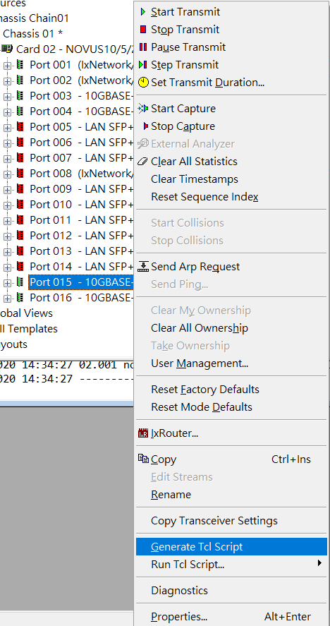
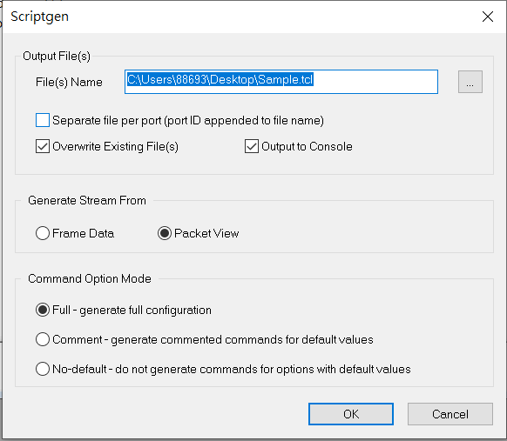
IxExplorer API
-ScriptGen
Notes:
ScriptGen is an auxiliary Tcl tool that is installed as part of the Tcl Client package. It’s purpose is to create a Tcl program which reflects the configuration of a particular port. ScriptGen is run from a Wish Console and the resulting program is written to disk and shown in the console window. The configuration of the port may have been established through the use of any of the following Ixia tools: IxExplorer, IxAutomate (formerly IxScriptmate), or TCL API. The operation of ScriptGen is described in Appendix A of the IxExplorer User Guide.

Slide 11
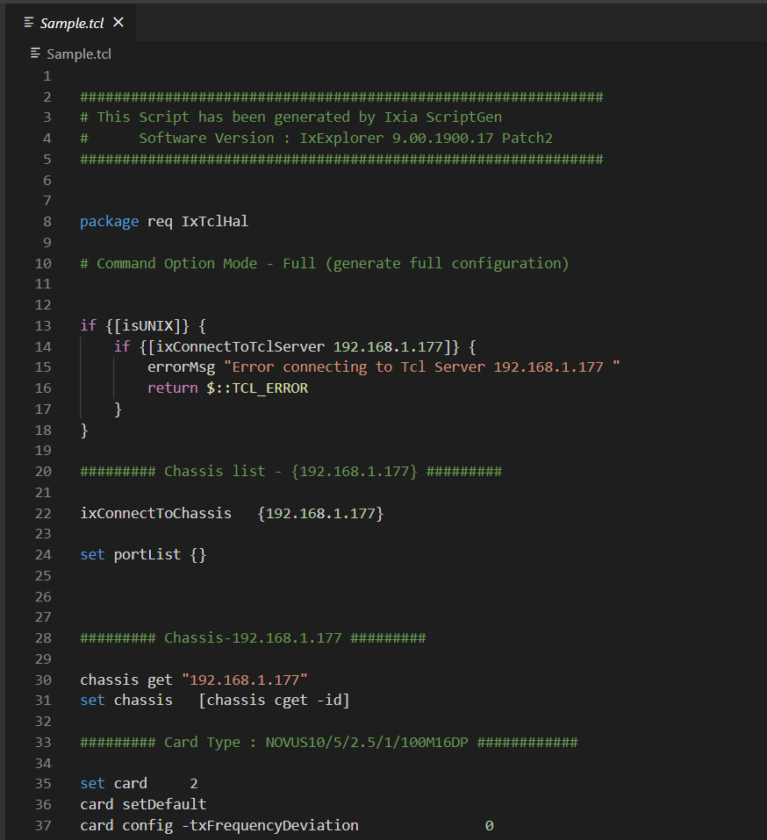
IxExplorer API
-ScriptGen
Detailed Config
-Completely Convert Chassis/Card/Port Config to Tcl Command
-Excluded Traffic/Capture Operation
Easily Execute
-Complier directly by IxExplorer Tcl Console

Slide 12
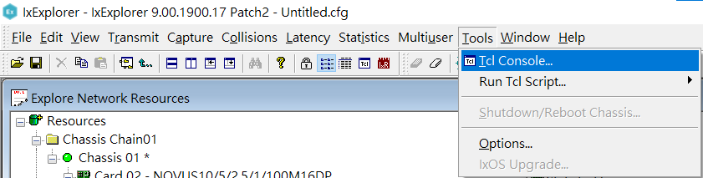
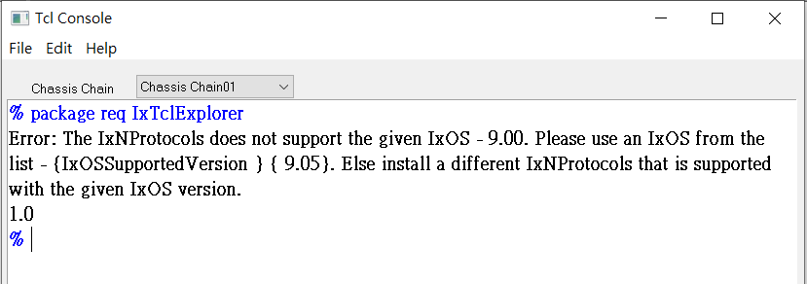
IxExplorer API
-Tcl Console
Wish(Tcl Complier GUI) with IxExploer environment
Full Function with IxExplorer
-Every function on IxExplorer can be executed on Tcl console by scripting command

Slide 13
IxExplorer API
-Manual Scripting
Clean Script
-Scripting just what you what
-Less command, less execution time
-Easy to debug
Traffic Operation
-Start/Stop Traffic by Scripting
Combine with test plan
-Scripting with DUT command/environmental setting

Slide 14
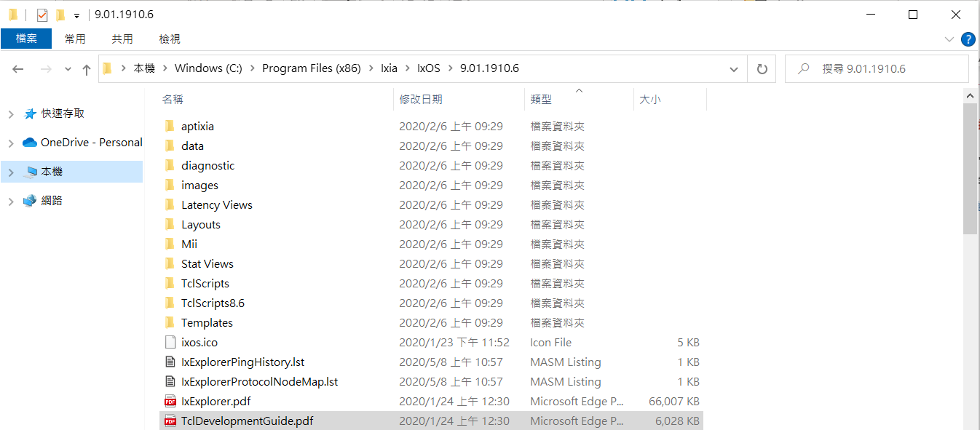
IxExplorer API
-TCL Development Guide
Full Command Information
-keyword search is best
Default Location:
C:\Program Files (x86)\Ixia\IxOS\(Version)\TclDevelopmentGuide.pdf

Slide 15
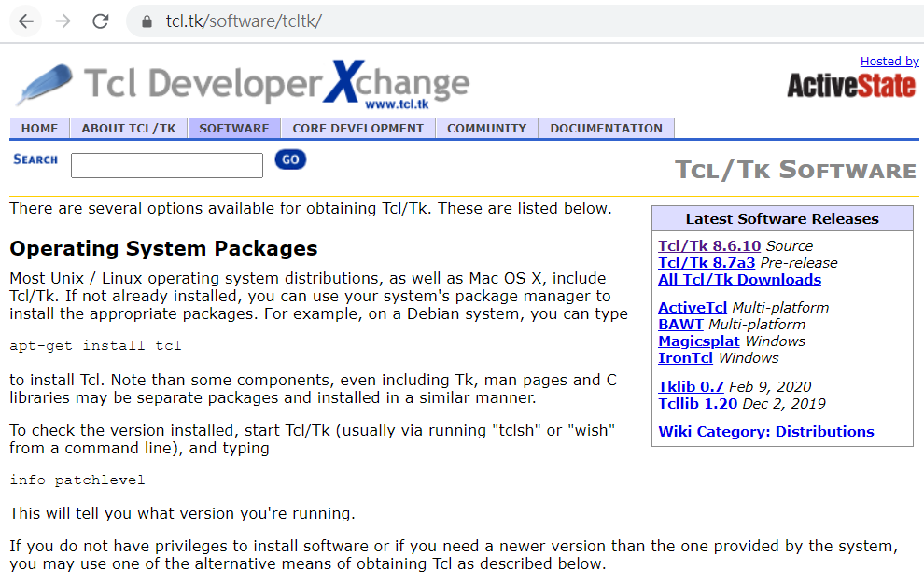
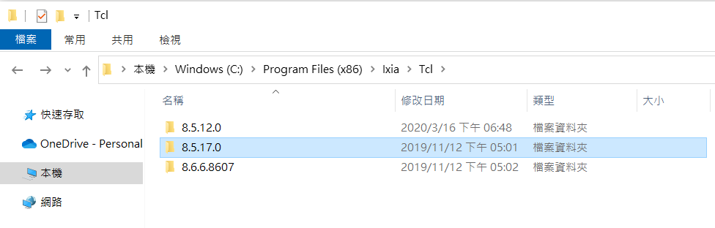
Environment setting
-Tcl in Windows
Download Tcl Setup on https://www.tcl.tk/software/tcltk/ or using Ixia default Tcl version

Slide 16
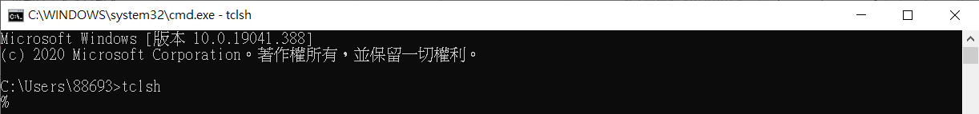
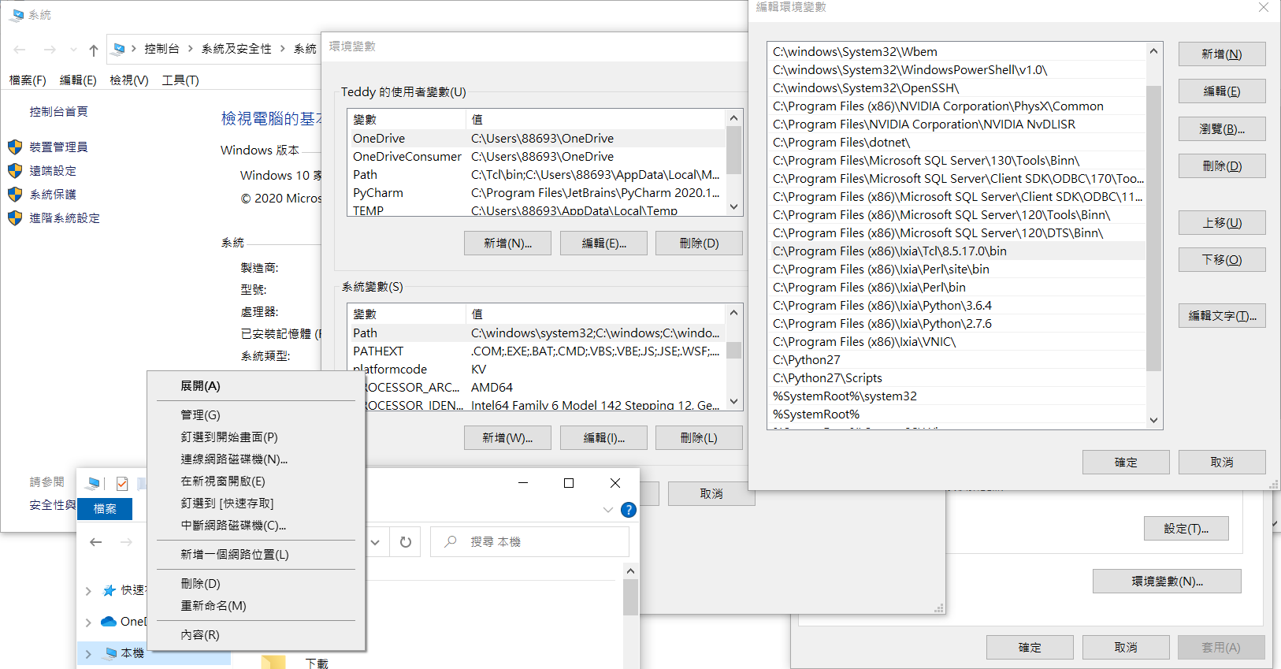
Environment setting
-Tcl in Windows
Check if Tcl directory is in environmental variable

Slide 17
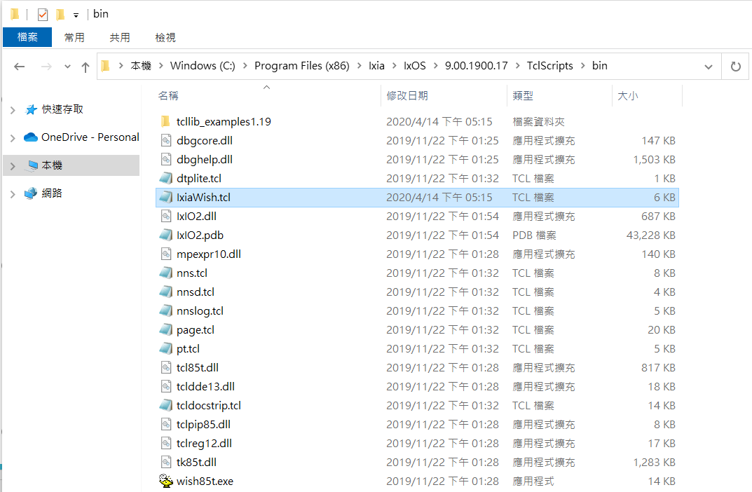
Environment setting
-Tcl in Windows
If not use Ixia Tcl console, need to source IxiaWish.tcl at first in script
Done

Slide 18
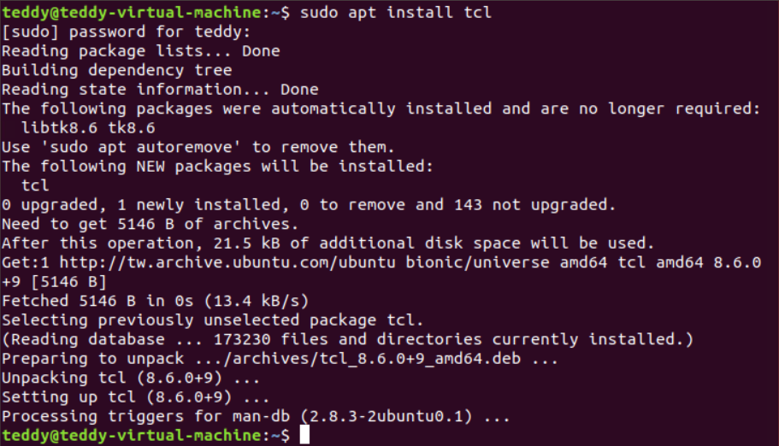
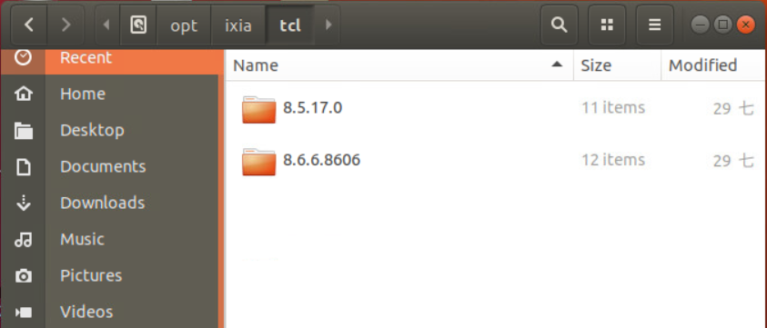
Environment setting
-Tcl in Linux
Use Ixia default Tcl version or using apt to install Tcl

Slide 19
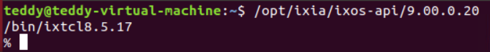
Environment setting
-Tcl in Linux
Check if Tcl directory is in environmental variable
Using Ixia Tcl Console
Done

Slide 20
Ixexplorer automation
-Solution
Tcl Script
-Bat file
-Combine with UI

Slide 21
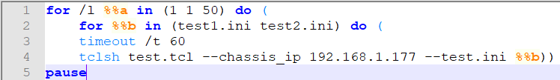
Ixexplorer automation - SOlution
-Bat file
Simple Task Scheduler
Quick deploy on windows

Slide 22
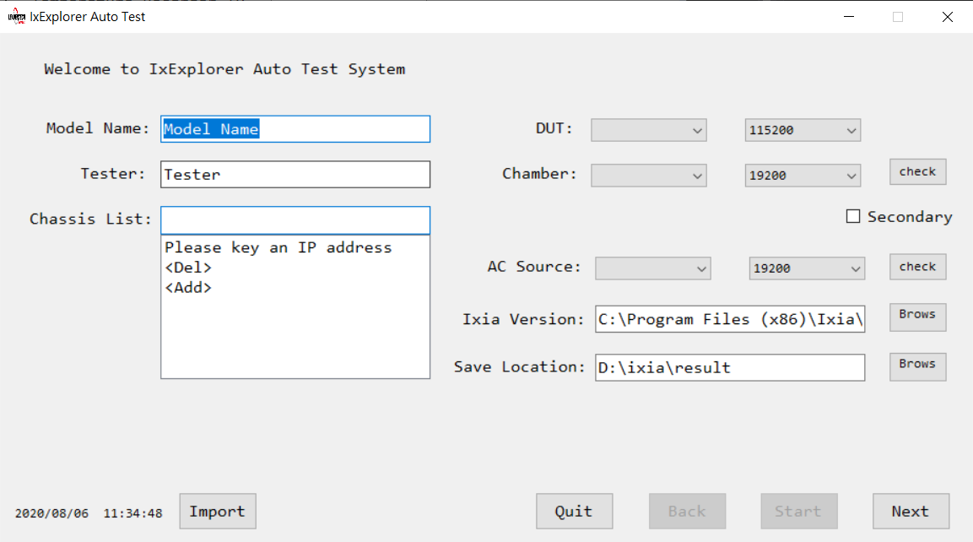
Ixexplorer automation - SOlution
-Combine with UI
Separate Config and Test
Test with environment setting

Slide 23
Ixexplorer Scrirt Demo

Slide 24
Ixexplorer Script
-Sequence of Steps
Load the IxTclHal package.
Connect to the chassis on which the test is to be executed.
Set up the traffic mapping
Set up test related parameters
Configure the port parameters
Configure the streams on the transmit ports
Configure the filters parameters on receive ports
Write the configuration into hardware
Start the transmission
Validate the received frames on receive ports
Output results

Slide 25
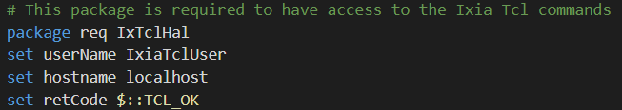
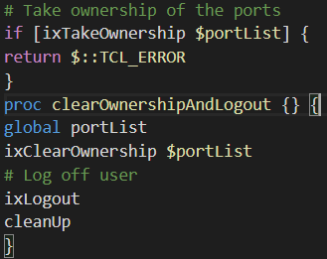
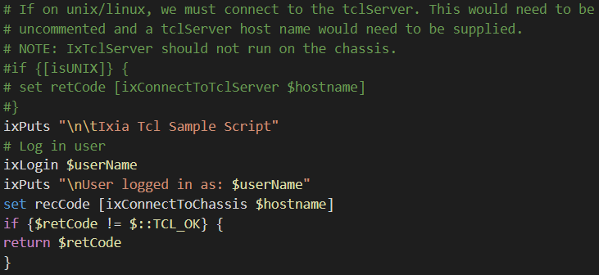
Ixexplorer script
Step by step
Load the IxTclHal package.
Load package and declare variables
Login and take ownership of the ports
Connect to the chassis on which the test is to be executed.

Slide 26
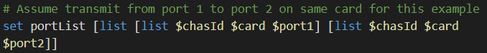
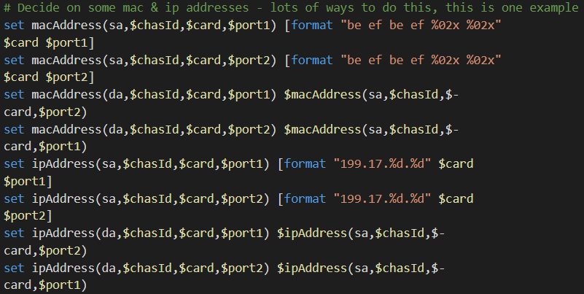
Ixexplorer script
Step by step
Set up the traffic mapping
Set up test related parameters

Slide 27
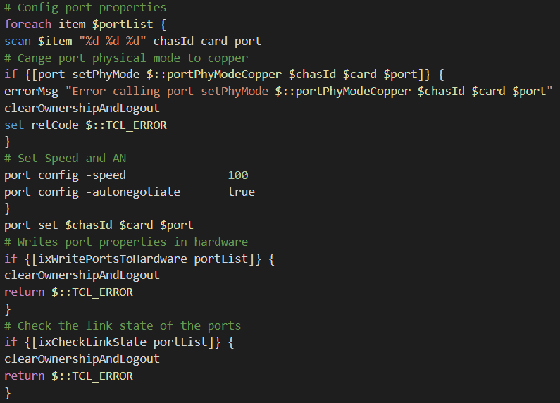
Ixexplorer script
Step by step
Configure the port parameters
Change port physical mode if needed
Write to hardware if needed after set
Check link state after write to hardware

Slide 28
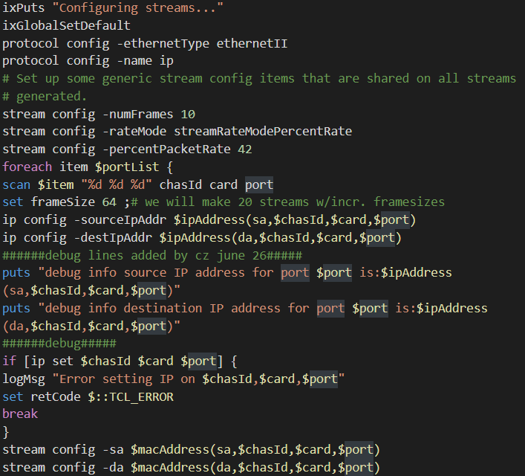
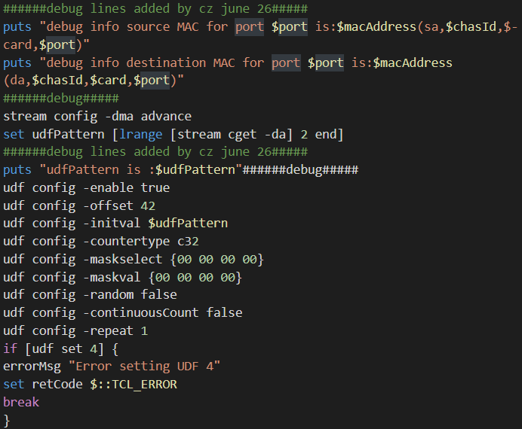
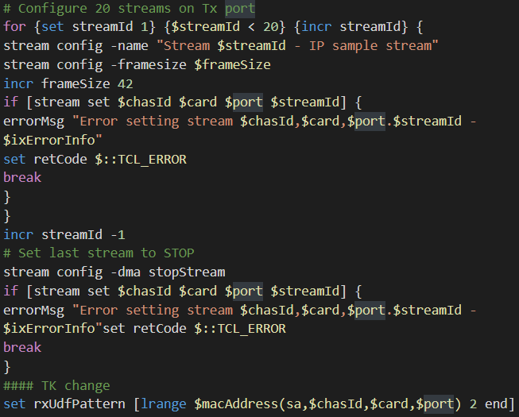
Ixexploer script
Step by step
Configure the streams on the transmit ports
Streams setting and Udf setting

Slide 29
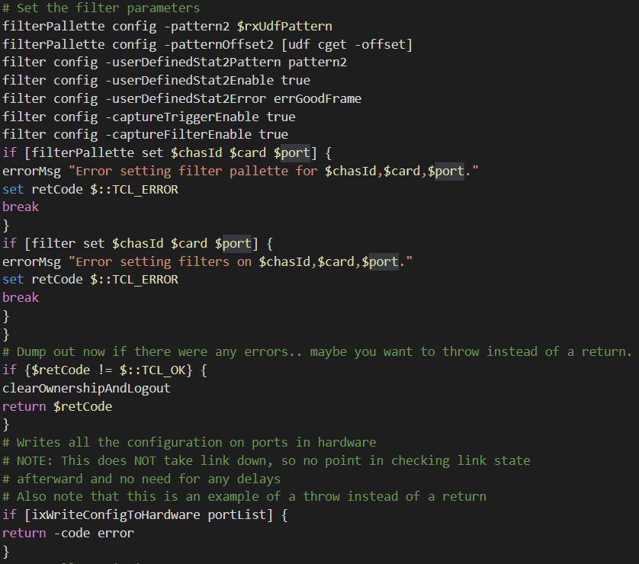
Ixexplorer script
Step by step
Configure the filters parameters on receive ports

Slide 30
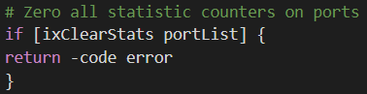
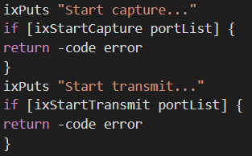
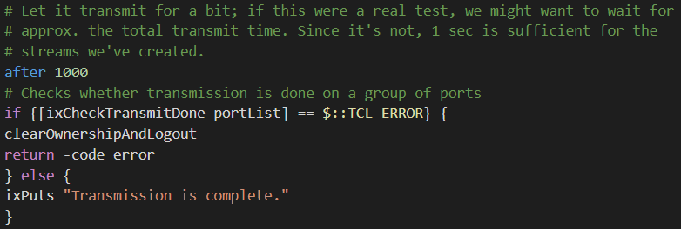
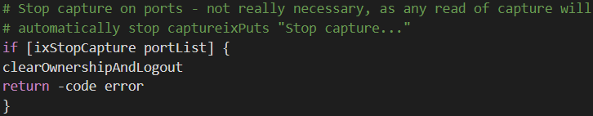
Ixexplorer script
Step by step
Write the configuration into hardware
It is better to write individually for card/port/stream when each setting needs some time to wait for hardware setting, but it cost more time than just one write for everything
Start the transmission
Clear statistics before transmission
Capture start if needed
After transmission time, check traffic state
Stop capture if capture needed

Slide 31
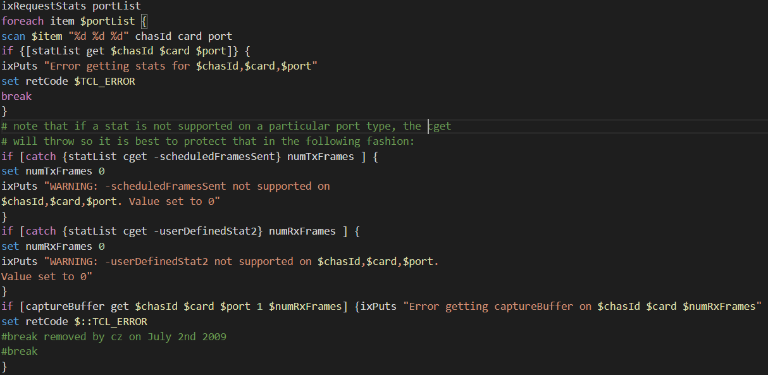
Ixexplorer script
Step by step
Validate the received frames on receive ports

Slide 32
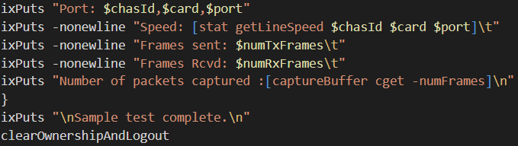
Ixexplorer script
Step by step
Output results
Puts results to console or others

Slide 33
Ixexplorer Script
-How to Write Efficient Script
Port Property Setting First
Set Port List as Array
Create Necessary Streams
Verify Filter before Use
Request Data with after Function
Notes:
It is important to configure the Port Properties in the very beginning of the script. For example, on a 10/100 card, there is an autonegotiation parameter. If this parameter is to be turned on, then during the auto-negotiation process, the link goes down and it takes a small amount of time to come up again. If there are a number of ports involved, the setting of port properties can take a long time. Therefore, we recommend that the ports be set first. This is done using the port set and port write commands. Do not implement this step in the middle of the script since it only slows down the total time of execution of the test.
To send and receive traffic on the ports, the transmit and receive port mappings must be defined and the port numbers stored in a structured array or list. This way, when streams and filters are to be configured, this array or list only needs to be looped through.
Before creating streams on the transmit ports, decide how many streams are needed to achieve the traffic profile to be used. It is possible that only one stream is needed in most cases. If not certain, use the IxExplorer GUI application to create the stream and transmit frames on it. Try to avoid creating streams for every iteration of the test. Sometimes it is easier to create all the necessary streams and simply disable the unneeded ones during the iterations.
To verify the filters, use the IxExplorer GUI to first mimic the situation. Use magic numbers in the payload of the frames wherever possible so that only the frames involved in the test are received. The magic numbers eliminate the inclusion of loopback, management frames or Spanning Tree BPDUs, for example, forwarded by the DUT.
If your script is running in a small loop and requesting data very quickly from IxServer, it is possible IxServer is not be able to keep up with the requests. If your script must request statistics or other data in a small for or while loop, consider using delays using the Tcl after command.

